Slide 1
Cybersecurity
Replay Attacks

Slide 2
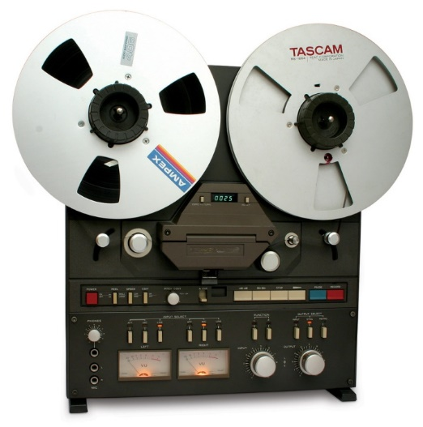
Replay Attack
Information exchanges happen on the network
Wired or wireless
Hackers can eavesdrop a network
ARP poisoning, network tap, malware
Digitally record the exchange (capture)
Examine data later for promising targets
Crack passwords/encryption used on network
Learn network infrastructure (MACs, IPs, gateways)
Replay the same data packets later
Authenticates and gets privileged access to network resources

Slide 3
Pass the Hash
Log into an account using only the hash
Attacker only has the password hash
Does not know the plaintext password
Attack bypasses the hash conversion and just compares
A normal log-in process converts the plaintext password to a hashed passwords and then compares this to what’s stored
A pass the hash attack simply just compares the two hashes (which will obviously be the same)

Slide 4


Pass the Hash Example
1. User sends hashed password to server to authenticate
2. “Attacker” obtains the password hashes
3. “Attacker” sends the password hashes along later to authenticate

